Slide 1
Python : Sequences

Slide 2
Content
Stack with lists
List comprehension
Expressions
Sequence processing function
Two-dimensional lists

Slide 3

Stack
# Create a stack

Slide 4
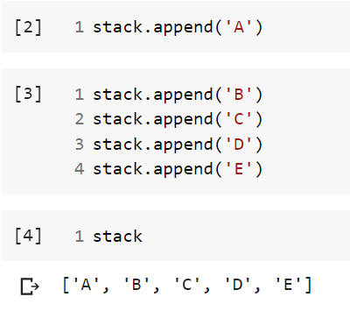
Push into stack

Slide 5
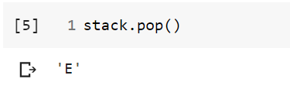
Pop from stack
Remove a value using .pop() method
Pop works from top element

Slide 6
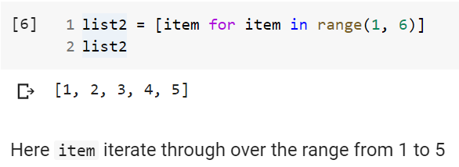
List comprehensions

Slide 7
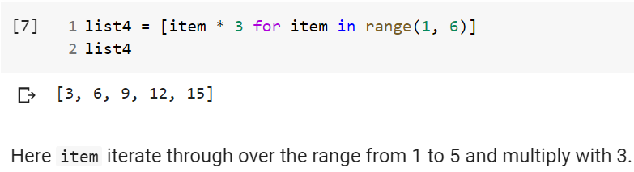
List comprehensions (contd. )

Slide 8
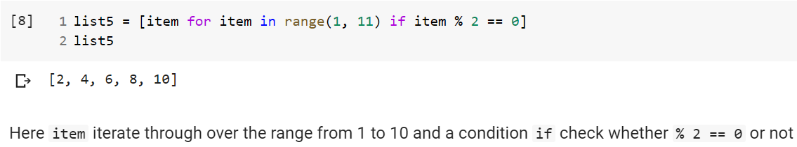
List comprehensions (contd. )

Slide 9
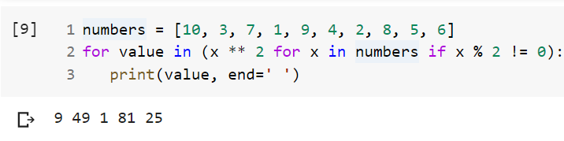
Generator Expressions
Examples shows that it print out the numbers that are odd along with square.

Slide 10
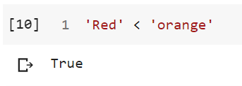
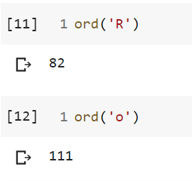
Sequence processing function
ord( ) function used for checking the numerical values

Slide 11
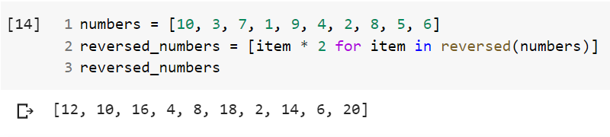
Reversed a sequence

Slide 12
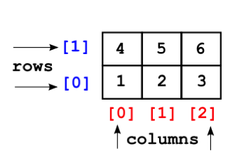
Two-dimensional lists

Slide 13
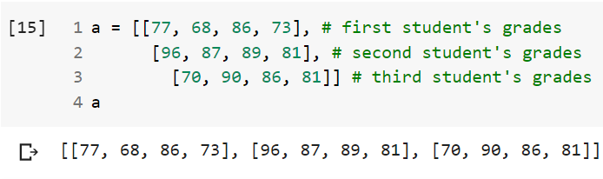
Create 2D list

Slide 14
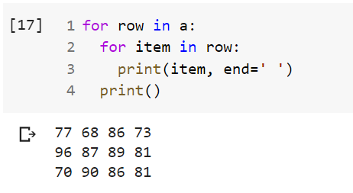
Iterate 2D list

Slide 15
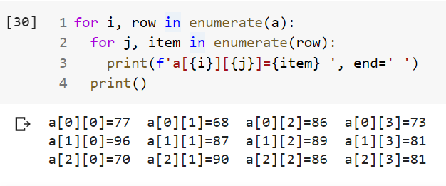
Bonus - Identify an Item

Slide 16
Thank you all !

